Slide 1
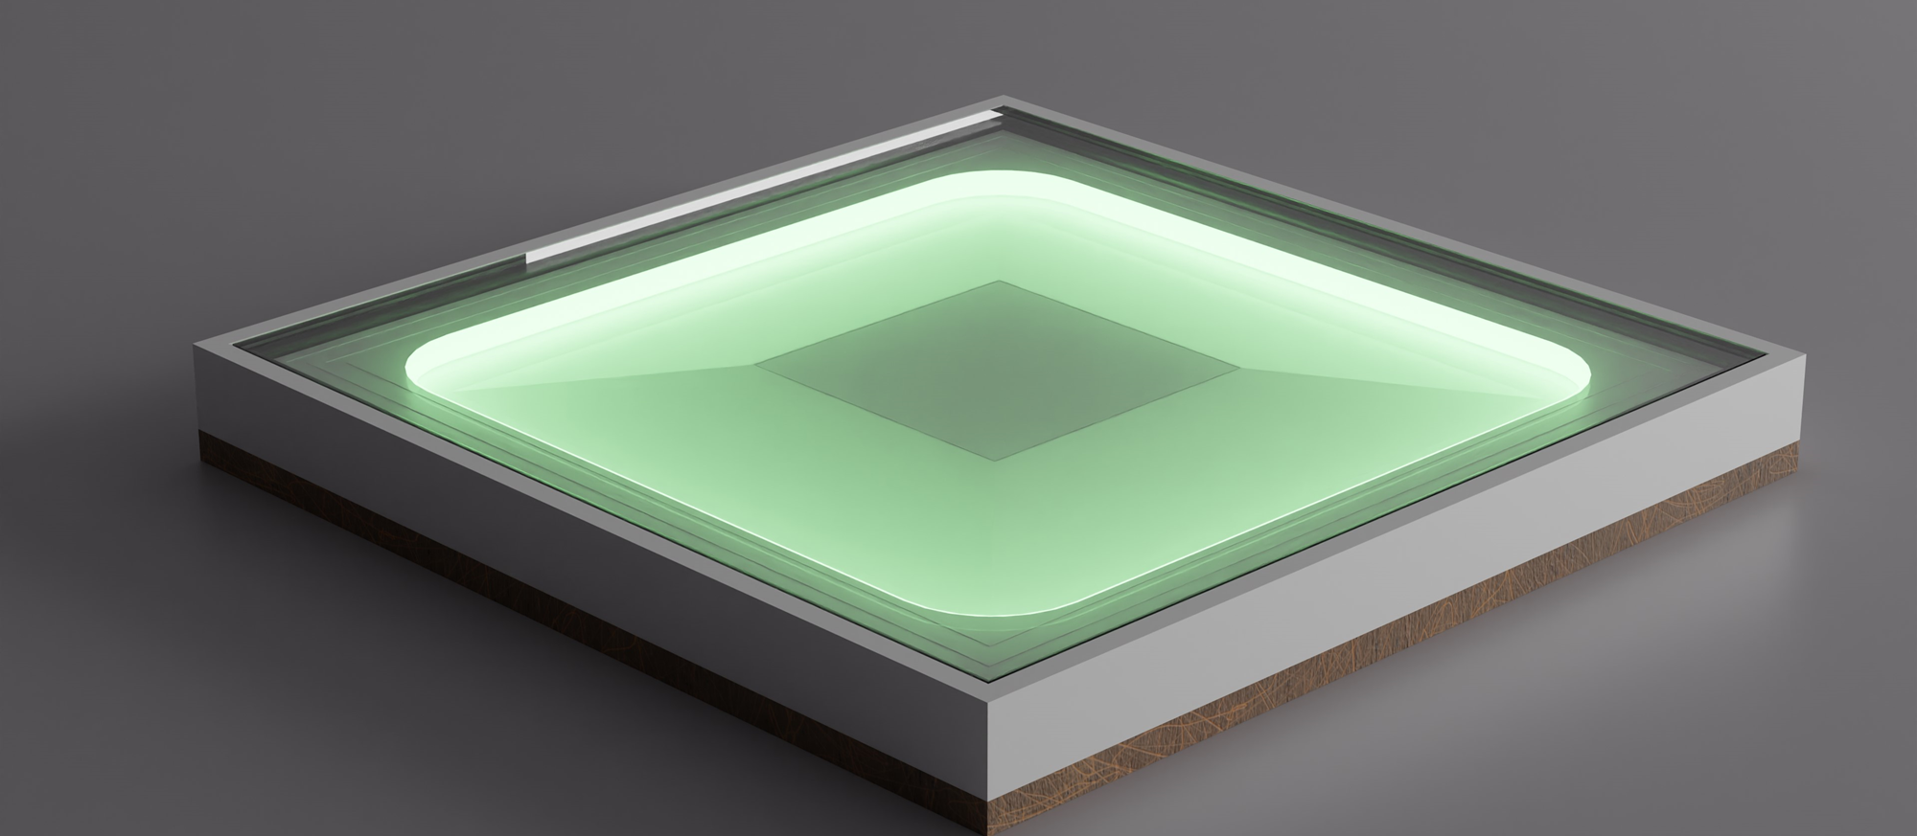
Music Light Tiles

Slide 2
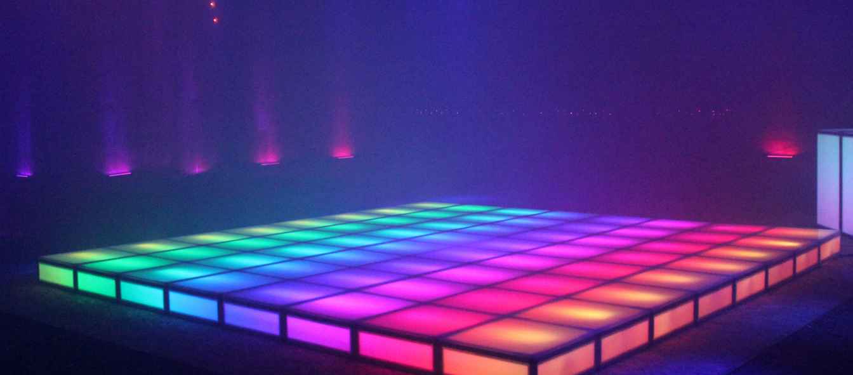
What is our project?

Slide 3
TeamMember 1
Rob Cocquyt
Person Detection
Documentation
Sounds
Rob cocquyt

Slide 4
TeamMember 2
Ruben Belligh
Person Detection
Documentation
Sounds

Slide 5
TeamMember 3
Luca Declerck
LED Strips
Web socket
Test Script

Slide 6

TeamMember 4
Alberiek Depreytere
Elektronica
Speaker
Sounds

Slide 7
Benodigdheden
Hout (400 x 400mm)
PLA
Speaker
Led
ESP-32
DC DC Step Down
Media Player
Aluminium Tape
Ruberen Strip
Polycarbonate (5mm)
Voeding

Slide 8
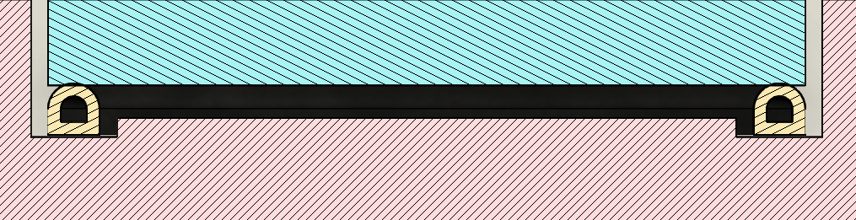
Detectie
AluminiumTape
Seal strip
Tested on 80kg

Slide 9
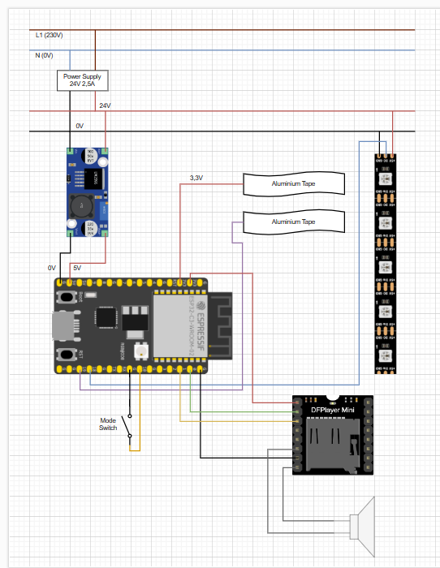
Elektrisch Schema

Slide 10
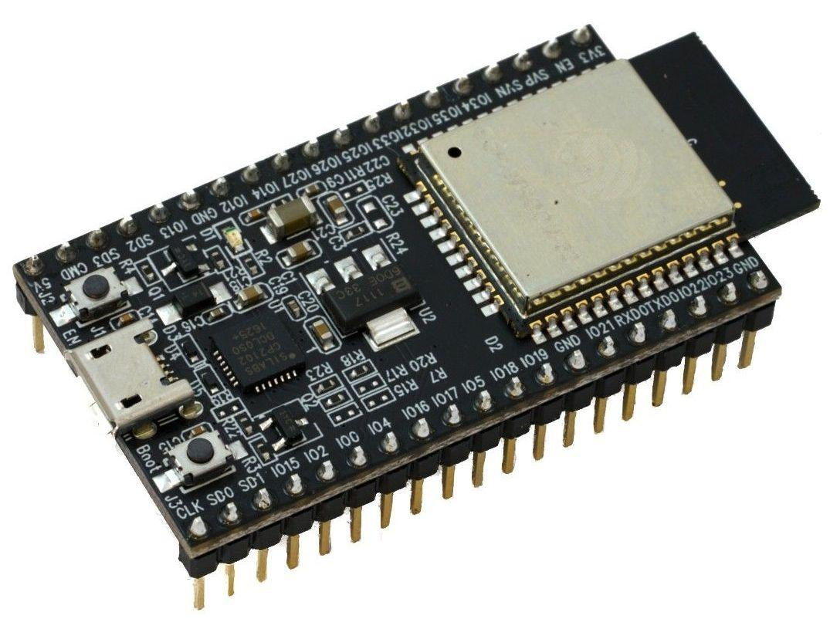
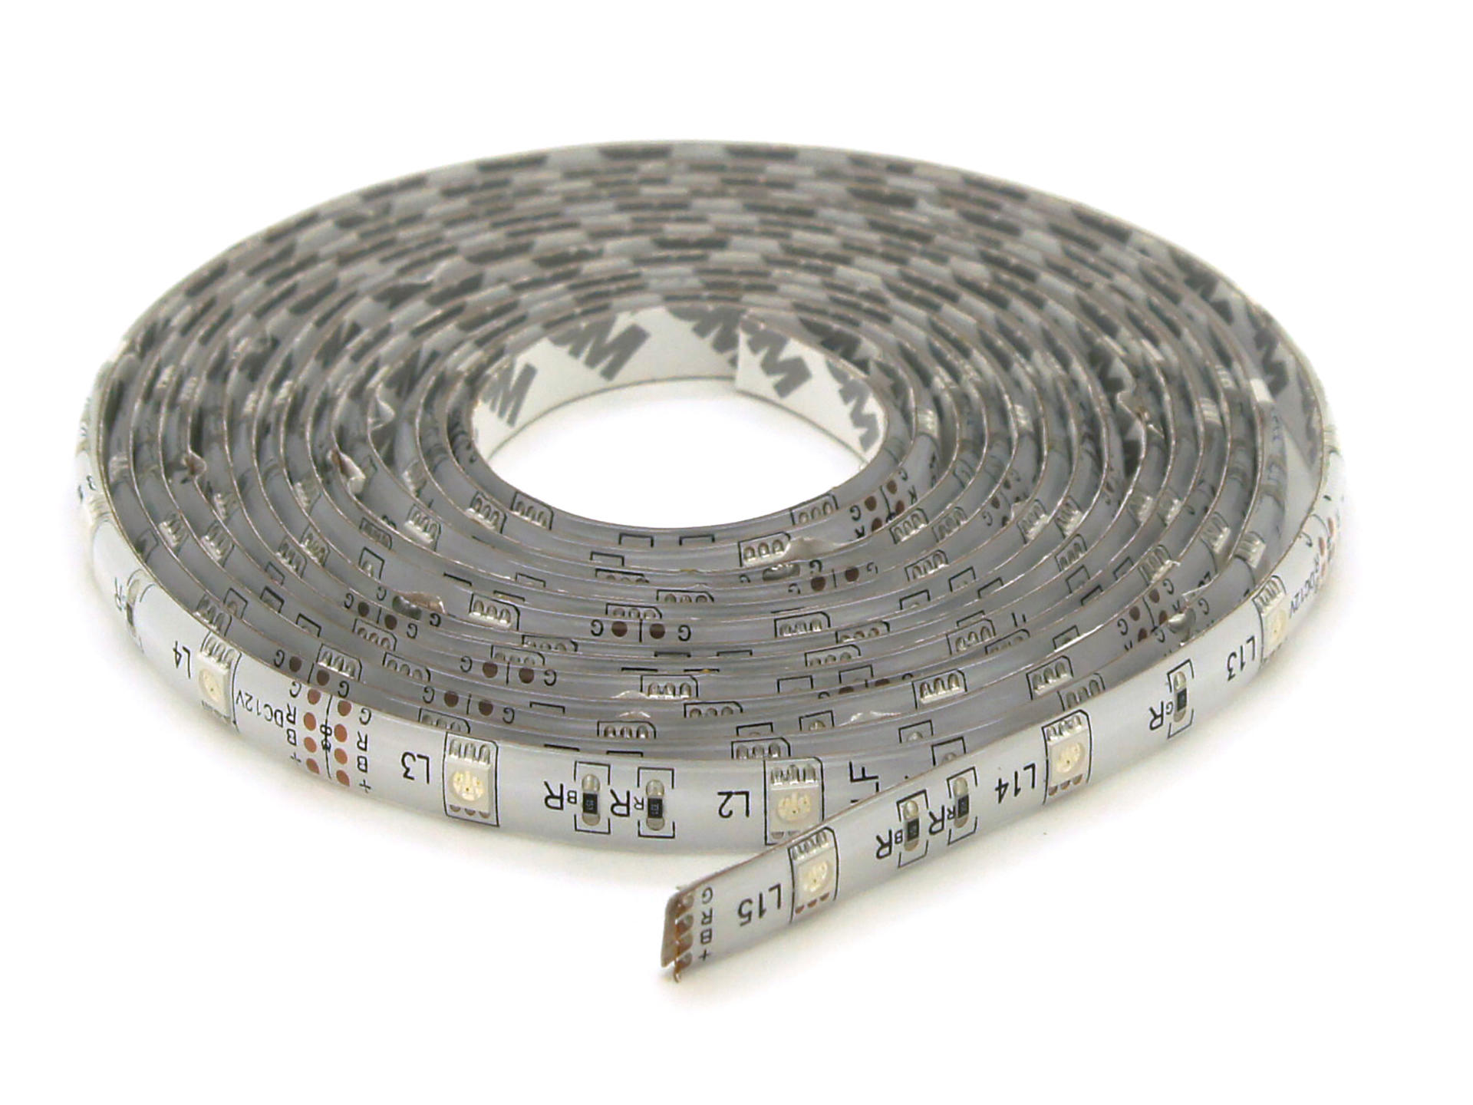
Probleem
ESP 32 = 3,3V LED Strips = 5V

Slide 11
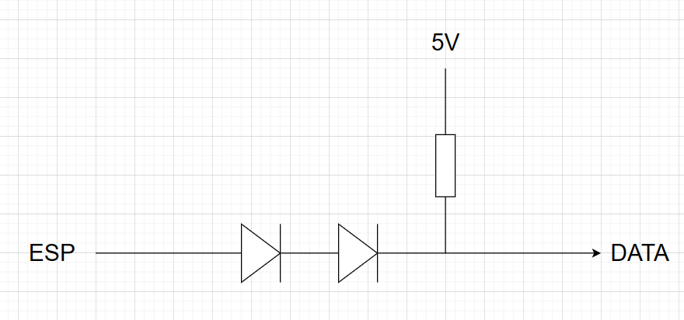
Oplossing
Quick and dirty

Slide 12
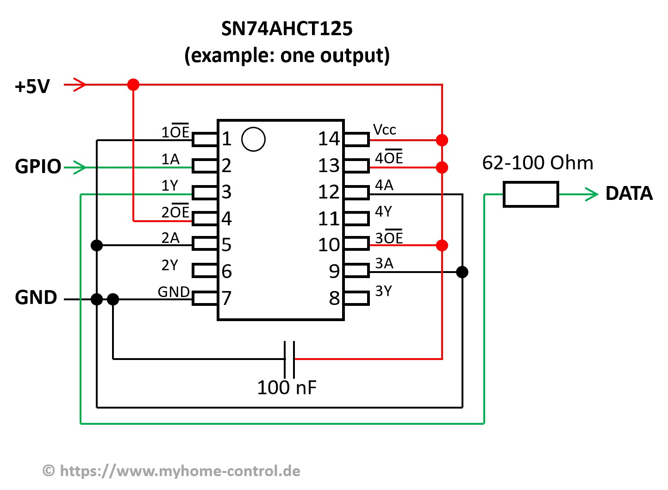
Oplossing
Level converter

Slide 13
Demo

